Slide 1
Critical Reading and note-making
Session 4

Slide 2
Learning outcomes
Identify key features of critical reading and note-making
  Use a critical approach to reading
Design a method for critical note-making
Explain benefits of critical reading and note-making

Slide 3
Activity 1:
Reading style and accuracy
Consider the passages you read last week about dehydration in older people.
How did you approach the task of comparing the two articles?
Which account did you consider more truthful and why?
How did you reach your conclusion?

Slide 4
Characteristics of a critical thinker
The ability to assess claims and make objective judgements on the basis of well supported reasons and evidence rather than emotion and anecdote. Critical thinkers are able to look for flaws in argument and resist claims that have no support.
Wade and Tarvis (2008), quoted in Aveyard et al (2011)A beginners guide to critical thinking and writing. p6.

Slide 5
Critical reading
Different from other forms of reading, e.g. skimming or scanning (useful for locating where info is in a text and to develop a general feel).
Requires that you focus attention more closely on certain parts of a text, holding other info in mind.
Involves analysis, reflection, evaluation and making judgements.

Slide 6
Things to think about when reading
See how the argument fits together
Remember the overall argument
Understand specific pieces of information
Recognise how reasons and evidence contribute to the main argument.

Slide 7
Often you need more information…
Search the literature
Where?
How?
https://newcollegedurham.blackboard.com/webapps/portal/execute/tabs/tabAction?tab_tab_group_id=_61_1

Slide 8
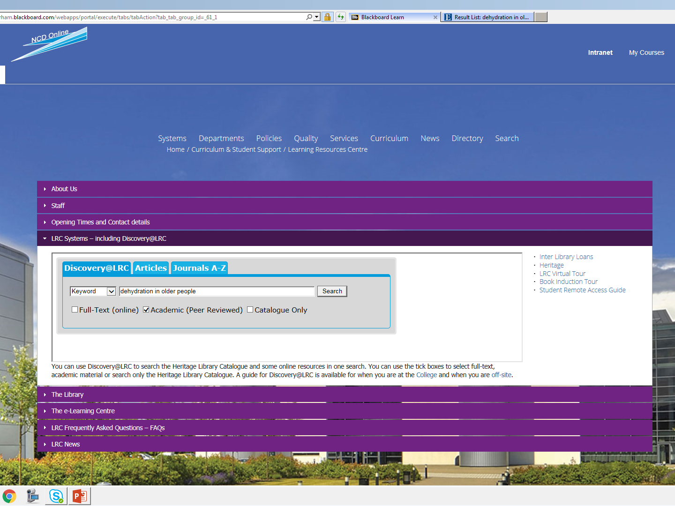

Slide 9
Books
Contents overview
Preliminary skim
Scan the introduction
Scan the final chapter
Scan beginnings and ends of chapters

Slide 10
Articles
Browse the abstract to see if it looks relevant.
If it does, read the abstract slowly, to identify the main argument.
Use the abstract to locate the most relevant information for you.
  Decide whether you need to know more about the methods used , the results, the discussion of the results, or the recommendations, depending on your purpose.

Slide 11
Research hypotheses sum up what the author is trying to prove
The results tell you what they found.
The discussion indicates those findings that were thought to be significant.

Slide 12
Find the argument
Identify the author’s position:
  what does that text want you to do, think, accept or believe?
  Look of sets of reasons that are used to support conclusions.
    Now you are placed to re-read, applying further critical thinking strategies.

Slide 13
6 Questions to trigger critical thinking
Where does the information come from
What is it (research, prof opinion, discussion) & what are the key messages
How has the author come to their conclusions- line of reasoning
Who has written/said this
When was it written/said
Why has it been written/said-what is the aim of information (Aveyard et al 2011)

Slide 14
Making notes to support critical reading
Why make notes:
  Breaks up continuous reading
  Involves motor memory
  Recall is easier when it is written in your own hand writing
  Selecting leads to greater interaction
  Draws information together
  Notes on text?

Slide 15
How do you make notes to support critical reading?
Your notes should be purpose specific.
Avoid making notes because they are interesting or might be useful one day.
If you’re making notes for more than one purpose, use separate sheets of paper, or clearly divide using headings.
Don’t just copy out – reflect on what you’ve read.

Slide 16
Prompt questions – note-making
What does this really mean?
Do the reasons support the argument?
Is there any supporting evidence?
Does this match what I know about the subject already?
Is this relevant and useful to my current purpose?
How does this add to previous research on the subject?
Are there any flaws?
  Tip: Read without a pen in your hand it avoids unnecessary notes

Slide 17
Things to ask yourself as you read
Who is the audience?
What are the claims?
What is the position of the author?
Are the points and arguments well developed?
Is the argument deep or surface level?
Do I agree or refute it and why?
How would I evaluate the content?
In what context is the writer making these claims?
Is the evidence convincing; how would I evaluate it?

Slide 18
Reading and noting for a purpose
If your main purpose is to keep notes to analyse an argument, use headings or a pro-forma to note:
  Details for finding the source again easily.
  The author’s position.
  The main argument or hypothesis.
  The conclusion(s).
  A list of the reasons used to support the conclusion. Number these.
  Your evaluations of the strengths and weaknesses of the line of reasoning and supporting evidence.

Slide 19
Activity 2: Concise critical notes
In small groups:
  Brainstorm: headings for making notes.
  On your flipchart sheet: draw up a pro-forma for making notes to analyse argument.

Slide 20
Tip for noting:
Keep separate sheets for notes on critical analysis and notes on facts and supporting details.
If the critical analysis sheets remain empty and the background information sheets mount up, you know you are not evaluating the information, and may indicate that you’ve slipped into copying the text.

Slide 21
Tips for choosing quotes
Use few quotations and keep them short.
  Quotes from secondary sources should sum up a point well in a few words.
  Quotes from primary sources should provide direct evidence for your argument.
  Always use the best and most relevant quotes.
    Tip: In your notes, use a highlighter to mark text you have copied, such as quotes – later you’ll be able to tell what is and isn’t your own words.

Slide 22
Summary:
Why critical reading and note-making?
To better manage time: avoiding making non-selective or non-critical notes.
To stop you from getting confused: losing references or forgetting what is and isn’t written in your own words can lead to plagiarism.
By developing skills in categorising and selecting information you can more easily
  find comparisons and exceptions
  link and connect information
  develop an understanding of the relative significance of different pieces of information
  make evaluative judgements.
Notes:
It is tempting to read and make notes in a non-selective or non-critical way, amassing piles of notes, then applying critical thinking to the notes.
This is ineffective time management as you are more likely to read and take notes on material you will not use, then repeat your reading of that unnecessary material in order to select what you need.
Making notes in an uncritical way can also leave you confused as to what is written in your own words and what has been copied out which can lead to you accidentally including an author’s work as you own, leaving you open to charges of plagiarism.
Developing skills in categorising and selecting information contribute to more effective reasoning abilities, as you find comparisons and exceptions, link and connect information, develop an understanding of the relative significance of different pieces of information, and make evaluative judgements.

Slide 23
Learning outcomes revisited
Identified key features of critical reading and note-making
Used a critical approach to reading
Designed a method for critical note-making
Explained benefits of critical reading and note-making

Slide 24

The great debate…

Slide 25
For next week…Should sugary drinks be taxed?
Find out 2 reasons to support and 2 reasons to refute this statement.
Reflect on the strengths of the argument using the prompts and critical questions
State your overall conclusion based on the strength of the evidence you have found

Slide 26
References
Aveyard,H;Sharp,P and Woolliams,M (2011) A beginners guide to critical thinking and writing in Health & Social Care. Berkshire. Open University Press

Slide 27
Primary and secondary data
Primary data – data that has been observed or recorded close to the event (nearest to the truth)Eg clocks telling time, thermometer recording temperature
Secondary data - existing sources of data eg routine hospital statistics; or a written source that interpret or record primary data. This may not report data from a primary research study directly but might refer to the study without giving full details

